Slide 1
Git & GitHub
Prepared by: Shrey P. Bechara
GID:-158312

Slide 2
What is git? Why is git around?
Git is a distributed version control system.
Benefits:-
Easily recover files.
Who introduced an issue and when.
Roll back to previously working state.

Slide 3
History of Version Control System
Local Version Control System.
Centralized Version Control System.
Distributed Version Control System(like git).

Slide 4
Git Features
Snapshot is captured.
.git folder is created where history of a project/files version is stored(invisible folder in a working directory).
Almost every operation is local.
Git has Integrity(i.e. every file have different checksum(i.e. unique string)).
Git generally only adds data.

Slide 5
Prerequisites
To use git more effectively it is always advised to know some basic commands of the Linux like pwd, cd, ls etc.
Git should be installed in a machine.

Slide 6
How to add repository AUTHOR username and user email?
git config --global user.name “Shrey Bechara”
git config --global user.email “shrey.bechara@einfochips.com”
How to check repository author name and email?
git config --get user.name
git config --get user.email

Slide 7
Git three stage architecture
Working Directory
Staging Area
Git repository
Checkout the project
Staging files
Commit(snapshot)

Slide 8
Basic command
git status
To check whether we are in any git repository or not. If we are there is there anything we have to stage or commit.

Slide 9
Basic flow to create git repository
git init
git add filename.extension
git add --a or git add .
git commit –m “Initial Commit”
git log
rm –rf (folder name)
Repository is created(.git folder)(hidden folder)
To add a particular file in a staging area
Add all files to staging area
To commit and to give a comment to a changes
It is used to know no. of previous commit done
To delete any folder

Slide 10
Other command
git clone (link(copy paste))
To copy existing repository to your repository

Slide 11
File status lifecycle
Untracked
unmodified
modified
staged
Add a file
Edit a file
Stage a file
Remove a file
commit

Slide 12
How to ignore unwanted file?
For single file:- By making .gitignore file(hidden in linux) and add filename.extension in it.
For multiple file:- If we want to ignore multiple file having same extension then in .gitignore file we have to add *.file extension(for eg *.c)
For entire folder:- if we want to ignore an entire folder then by add folder name with / in .gitignore file we can do that(for eg foldername/)
If we are having two folders with same name but want to ignore the outer folder only then we have to add /foldername/ to .gitignore file
If we are having two folders with same name but want to ignore the inside folder only then we have to add foldername/foldername to .gitignore file
NOTE: If file or folder once tracked by git and after that if we want to ignore that particular file or folder then after adding it into .gitgnore file we must enter this command also
# Remove the debug folder from Git's tracking history git rm -r --cached <file/folder name>

Slide 13
Git Commands
How to compare working directory with staging area? git diff
How to compare difference b/w previous commit and current staging area? git diff --staged
How to skip staging area and directly do commit? git commit –a –m “Commit msg”(this command is valid for tracked file only)
How to delete a file using git command? git rm filename.extension (it also add changes to staging area)
How to rename a file using git command? git mv existing_filename.extension new_filename.extension
If we want to ignore existing tracking file? We can to do this using git rm –cached filename.extension (it also add changes to staging area).
How to view previous commit with diff? git log –p OR git log –p –num(1,2 etc)[it will list number of commit user want to see with diff](-p==--patch)

Slide 14
Continue..
How to see a commit with diff in a SUMMARY form? git log –-stat (--stat==--shortstat)
How to see all commit at a time in minimalistic form? git log --pretty = oneline or short or full
How to add filters in a commit? git log --since = 2.days or weeks or months or year
How to view commit in any specific format form? git log –pretty=format :”%h--%an” (here %h=commit checksum and %an=author name) [website:- Git - git-log Documentation (git-scm.com)→pretty formats]
How to change the status from staged to modified? git reset <filename_extension> (for single file) AND git reset *.extension (for all files having same extension)

Slide 15
Continue..
How to UNDO the changes done in files(i.e. to restore imp. info changed by mistake)? git checkout filename.extension
How to UNDO all the changes done in working directory i.e. matching current working directory with the previous commit? git checkout .
How to give alias to a big command? for single word: git config --global alias.(newname) AND for multiple word: git config --global alias.(newname) ‘(jiska alias krna hein)’
How to change a commit msg? git commit –amend
How to change default text editor in git? git config --global core.editor “text_editor_name“

Slide 16
Creating and switching branch
How to create a branch? git checkout –b new_branch_name (it will create new branch and it will switched to a new branch)
How to switch branch? git checkout branch_name
How to see list of branch available in repository? git branch
How to show latest commit hash and commit message? git branch –v (-v == --verbose)

Slide 17
Git Merge & Git Rebase command
Merge and Rebase both are used to integrate the changes from one branch to another branch in a different way.
Git Merge:-
How to merge branch with master branch? git merge master
What is Merge Conflict? A merge conflict is an event that occurs when Git is unable to automatically resolve differences in code between two commits.
Advantage:
It maintains separate history of master branch and other branch.
Ideal for use in collaborative work.

Slide 18
HEAD
Master M1
Feature branch F1
HEAD
commit history
F3
M3
M2
F2
HEAD
F2
F1
M1
HEAD
M2
HEAD
M3
F3
HEAD

Slide 19
Command used when we want to avoid merge conflict by adding branch.
git merge <branch_name> --strategy-option=theirs
By using above command the branch name mentioned changes will be only considered while merging.
git merge <branch_name> --strategy-option=ours
By using above command, with whom branch is merging changes will be only considered while merging.

Slide 20
Continue..
Git Rebase:-
How to rebase branch with master branch? git rebase master
Advantage:
Linear commit history
Disadvantage:
It rewrite the commit history.
It is not advised to be used when collaborative project takes place as commit history rewrite due to which tracking is not possible/difficult.

Slide 21
Without Git Rebase command
HEAD
Master M1
Feature branch F1
HEAD
F2
HEAD
HEAD
M2
HEAD
M3

Slide 22
After Applying
Git Rebase command
M1
M2
commit history
F2
Master HEAD
F1
M3
M3
M2
F1
M1
F2
Feature HEAD

Slide 23
Branch Management
How to see list of branch already branch merged? git branch --merged
How to see list of unmerged branch? git branch –-no-merged

Slide 24
How to delete local & remote branch?
Local branch:-
git branch –d branch_name(if merged)
git branch -D branch_name(if not merged)
Remote branch:-
git push origin --delete branch_name OR git push –d origin branch_name

Slide 25
Git Patch
What is Patch? It is a file, Consisting of changes of codes(features) in branch that is applied/added with master branch[Note:- firstly changes must be staged & commit] then
How to make patch file? git format-patch (name of branch with which it is compared) –o (filename).
How to apply that file? git am patch/string(already displayed in terminal) then enter (features will be added in master branch).
We can also create patch using. git format-patch –x (x = commit which we want to create patch from branch)
We can also use git apply patch file name to apply patch
Git format patch command create patch from commits but we can also create modified area by using git diff >> . Patch file name

Slide 26
Git Push & Pull command
Git Push:-
Steps:-
git remote(it is used to check whether remote repository is linked or not) if not then git remote add name(origin) url(copy paste)
For first time:- git push –u origin master ELSE git push

Slide 27
Continue..
Git Pull:-
Git pull is used to fetch & merge changes from the remote repository to a local repository
git pull= git fetch + git merge
git fetch:- It is a command used to downloads content from required remote repository.
git merge:- It is a command combines multiple sequences of commit into a single branch.
git pull URL(copy paste)

Slide 28
How to delete local & remote commit?
Local:-
git reset <commit hash> This command will delete the commit and any changes made in that commit will be removed from the repository.
If you want to keep the changes made in the commit, but just remove the commit from the repository, you can use the git reset --soft <commit hash> command instead.
Remote:-
There is no specific command to delete a remote commit in Git, as deleting a commit from a remote repository requires a more involved process than simply deleting a local commit.

Slide 29
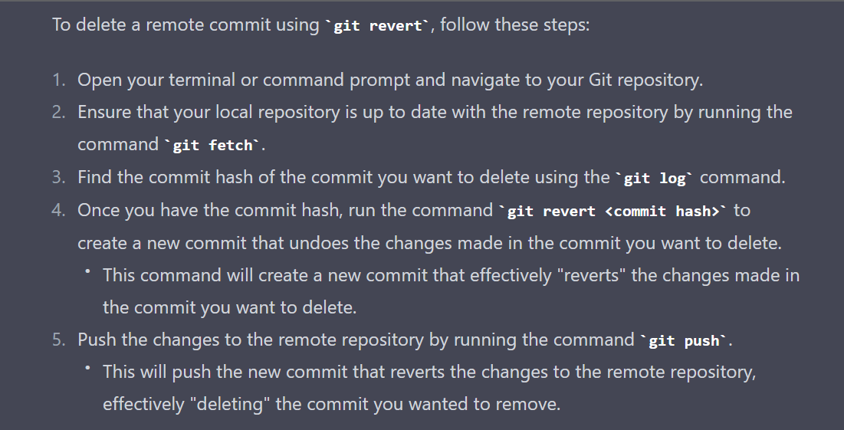
It's important to note that when you delete a commit from a remote repository, you are effectively rewriting history. This can cause issues if other people have already pulled the changes from the repository.

Slide 30
What is HEAD? How to change HEAD position?
HEAD:- It is a reference to a current commit in the branch you are working on. It is essentially a pointer to the most recent commit on the current branch.
There are basically 4 ways to change a HEAD position?
You can change the position of the HEAD to check out a specific commit, which allows you to view the code at a particular point in time. This can be useful for debugging or troubleshooting issues. You can do this by running the command git checkout commit_ID(HEAD will point to this commit_ID)
git checkout branch_name
You can change the position of the HEAD to move backwards or forwards through the commit history. For example, you can move back one commit by running the command git checkout HEAD~1
If you've made some changes that you want to undo, you can change the position of the HEAD to a previous commit and discard those changes. This can be done using the command git reset –-hard commit_ID

Slide 31
Git Tags
Tags:- tags are ref's that point to specific commit in Git repository. It is like a bookmark that you can use to mark important or significant points in the history of our codebase, such as a release or a major milestone.
Tags in Git can be either lightweight or annotated.
Creating a lightweight tag: git tag tag_name commit_ID(ID on which you want to tag)
Pushing tags to remote: git push --tags
Listing tags: git tag
Deleting a tag(local): git tag -d tag_name

Slide 32
Continue..
Creating an annotated tag: git tag -a tag_name (assuming making a tag on current commit) This will open up a text editor where you can enter the tag message and additional information.
Showing Annotated Info of a tag: git tag -n tag_name
If you want to delete a tag in a remote repository: git push --delete origin tag_name

Slide 33
Git Stash
Git Stash:-The git stash command takes your uncommitted changes (both staged and unstaged), saves them away for later use, and then reverts them from your working copy.
Various commands of stash:
git stash
git stash list
git stash apply (it will apply latest stash) OR git stash apply <num>(for applying specific stash)
git stash push -m “msg”
git stash drop (it will drop latest stash) OR git stash drop num
git stash pop(it will pop latest stash) OR git stash pop num :It is used to apply a stash and remove it from the stash list.
git stash clear

Slide 34
Git Revert/Cherry Pick command
Git Revert:-
When to use? Suppose if we have pushed unwanted commits from our local then this will help you to get back “HEAD” to normal
git revert commit_ID(wrong commit_ID)
X

Slide 35
Continue..
Git Cherry Pick:-
When to use? This is mostly used when we have to make some hotfixes on run production(master) branch.(i.e. kisi bhi single commit ko cheery pick karke, merge karna(mostly probably used in multiple branch k commit ko merge karne k liye)(with your master))
git cherry-pick commit_ID
If conflict arises then resolve it, then use git cherry-pick --continue to resume the cherry-pick process.
If you decide to abort the cherry-pick process for any reason, you can use git cherry-pick –-abort to revert the changes and return to your previous state.

Slide 36
How to Add Current Branch tag after pathname in terminal?
It involves a series of steps
Step 1:
gedit/vim/nano ~/.bashrc
Step 2:
Copy paste the following path at the EOF
PS1='\[\033[01;32m\]\u@\h\[\033[00m\]:\[\033[01;34m\]\w\[\033[00m\]$(git branch 2>/dev/null | grep -e "^*" | sed "s/* //")\$ '
Step 3:
run the following command on terminal source ~/.bashrc

